Slide 1

Building a Production Grade PaaS like Bluemix on OpenStack

Slide 2
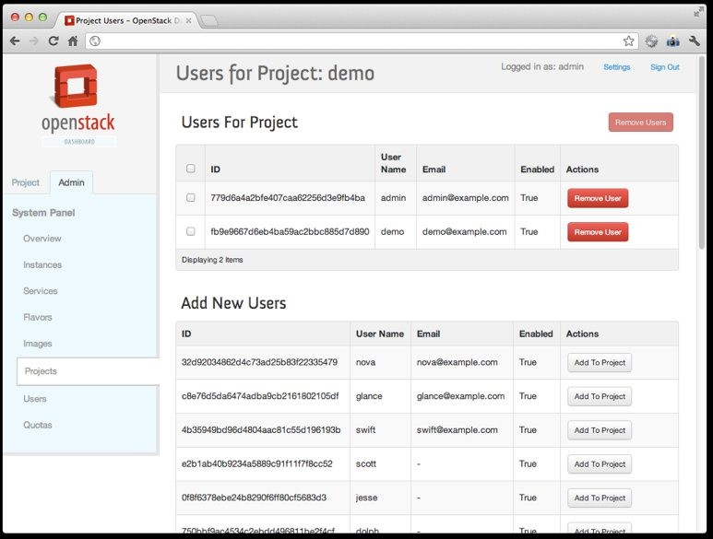

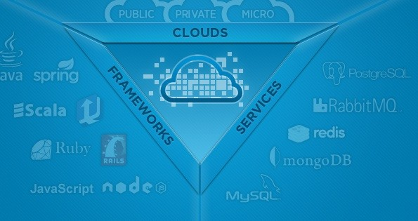






Building a Production Grade PaaS Platform like Bluemix on OpenStack
http://www.meetup.com/OpenStack http://www.meetup.com/CloudFoundry
Apps

Slide 3

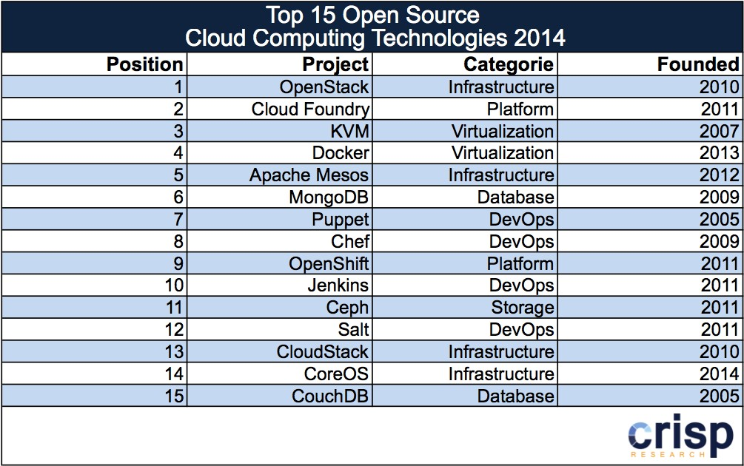
Cloud Foundry & OpenStack - Top Two Open Source Cloud Technologies!
http://analystpov.com/cloud-computing/top-15-open-source-cloud-computing-technologies-2014-24727

Slide 4






























IBM Cloud is open by design
OAuth
Cloud Business Apps
Digital Innovation Platform
World Class Cloud Infrastructure
Hybrid Cloud

Slide 5
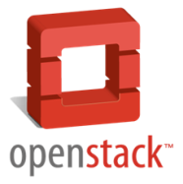




































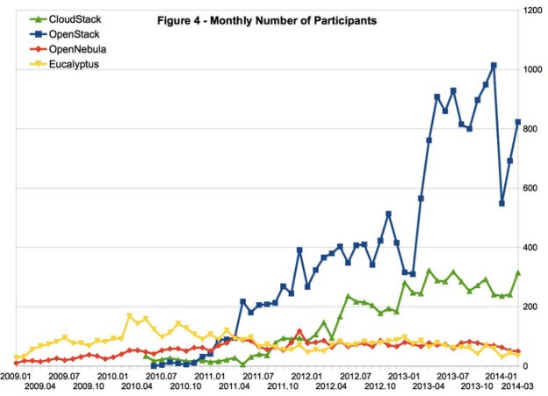


IBM is working to accelerate OpenStack Foundation success
Mar 2013
Exponential growth
Mar 2015
Because an open interoperable Cloud is critical for flexible cloud deployment and customer success…
859
Contributors
3452
Contributors
8,500 Members
21,353 Members
21
IBM has 19 core contributors
Platinum Sponsors
Gold Sponsors
2
IBM is #2 in contributions to OpenStack integrated projects
OpenStack Participant Growth
+100
IBMers active developers OpenStack projects
+400
IBMers working on OpenStack – from formation of the Foundation to Code Quality & New Function
5

Slide 6

Bluemix - What it is?

Slide 7





IBM Bluemix
IBM Platform as a Services offering
IBM Bluemix
Check In Code
IBM and partner cloud services
Lifecycle Management IDS
Check In Code
Integrated DevOps with both Browser and Eclipse-based tools
Create & Manage Services
Web IDE
(Eclipse Orion)
Application Composition Environment
Eclipse IDE
Explore Services
Explore Services
Test/Run
Application Runtime
Test/Run
Runtimes & Frameworks
Node
Java
WebSphere Liberty
Ruby
Worklight
Services
Middleware
Application
Data
Operational
Mobile
External

Slide 8

















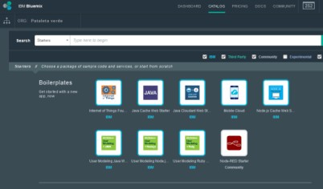



Bluemix allows developers to focus on the code
Microservices
IoT
Mobile
Design Thinking
APIs
Extreme Agile
Containers

Slide 9
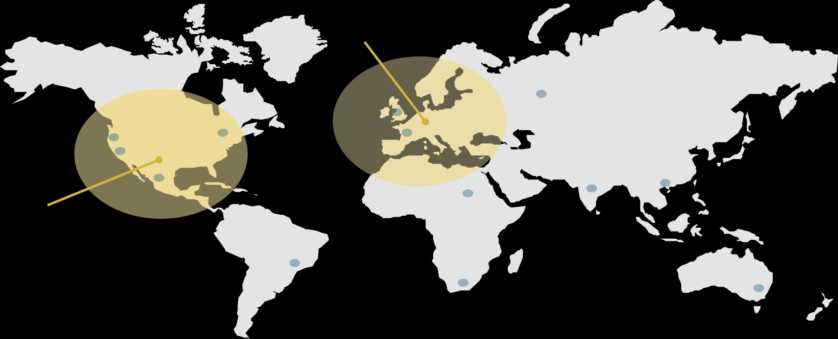
Global rollout of Bluemix
EU South (London)
US South (Dallas)
Leveraging IBM SoftLayer global presence. Bluemix dedicated is available in any location.

Slide 10


Bluemix powered by Cloud Foundry
A polyglot “platform for the people”
Quickly becoming the de facto open PaaS platform
Foundation established Dec. 2014; Executive Director & Board named Feb. 11, 2015

Slide 11
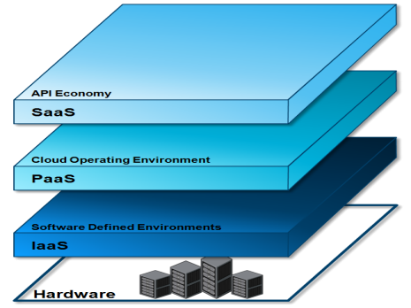
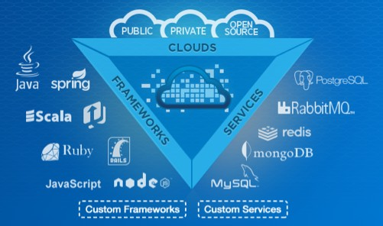









Bluemix powered by Cloud Foundry
Open Cloud Platform
There is an increasing appetite for cloud- based mobile, social and analytics applications from line-of-business
executives - drives the need for a more open cloud development platform
Compelling Community
Cloud Foundry has a compelling community and emerging ecosystem as well as a mature set of capabilities and robustness
Meets Developer’s Needs Focus on app development, not provisioning VMs, databases, messaging servers, etc
Agile development model Deploy and scale in seconds
TOTAL CONTRIBUTORS
1.3k
LINES OF CODE
800k
Platinum Founding Sponsors

Slide 12

















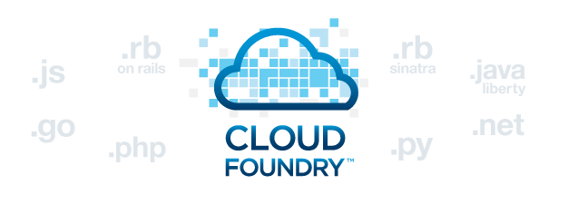







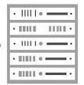
New: Bluemix Local
DevOps Tooling
Integration and API Mgmt
Your Own Hosted Apps / Services
Catalog of Services that Extend Apps’ Functionality
Web | Data | Mobile | Cognitive | Analytics | IoT | Security | Yours | +
Flexible Compute Options to Run Apps / Services
Instant Runtimes Containers
+ +
Platform Deployment Options that Meet Your Workload Requirements
Virtual Machines
+
+
Bluemix
Public
Bluemix
Dedicated
Bluemix
Local*
+
Powered by IBM SoftLayer
In Your Data Center
*Bluemix Local coming Summer 2015
12

Slide 13
IBM Cloud Manager with OpenStack What it is?

Slide 14
IBM Cloud Manager with OpenStack (ICM)
Runtime policies for ongoing VM optimization
Application High Availability (HA)
Simplified end-user self-service portal
Approvals, metering, billing, users and projects through a single ‘pane of glass’
Is a 100% complete OpenStack distribution
Extends OpenStack
– Heterogeneous management across any x86 environment, IBM Power and IBM System z
– Manage multiple OpenStack domains including legacy VMware
Is supported by IBM
Five (5) years of support with an optional three (3) year extension
Upgrades
IBM Services and business partners like Lenovo
Simplified installation and configuration using Chef
Improves application performance
Reduces infrastructure costs
 | Power | x86 | System z
Hypervisor / Compute Node | PowerVM via PowerVC | PowerKVM | ESX via vCenter | ESX | Hyper-V (2012 Svr) | KVM (RHEL 6.5) | z/VM via OS | zKVM
Guest OS | AIX pLinux SUSE pLinux Redhat | SUSE Ubuntu LE | Windows Linux SUSE Linux Redhat | Windows Linux SUSE Linux Redhat Other Linux | Windows Linux SUSE Linux Redhat Other Linux | Windows Linux SUSE Linux Redhat Other Linux | zLinux SUSE zLinux Redhat | zLinux SUSE zLinux Redhat
First Supported | 4Q13 | 2Q14 | 2Q13 | 2Q14 | 2Q13 | 4Q13 | 4Q13 | tbd

Slide 15
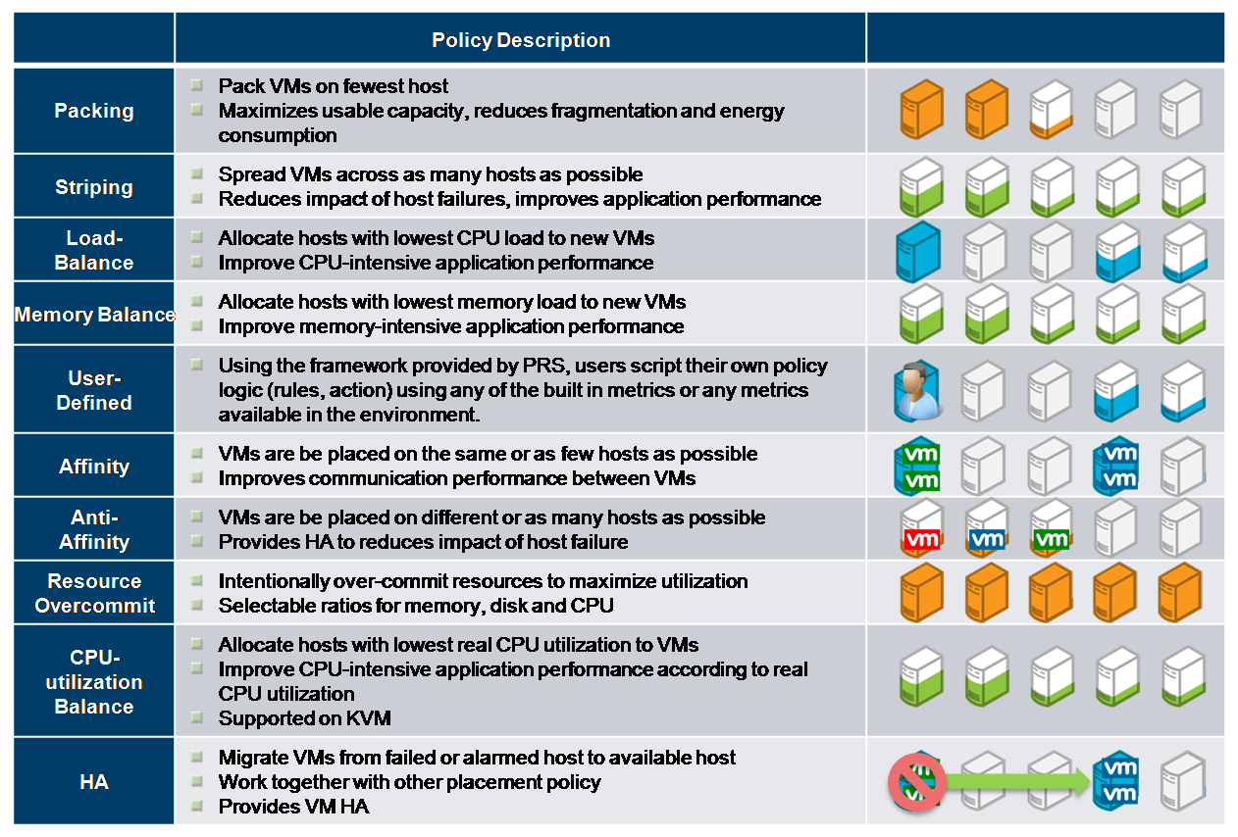


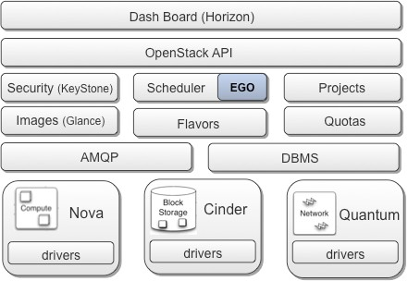
ICM Platform Pluggable Scheduler
Intelligent and policy driven Virtual Server Placement
Supporting use cases for virtual server deployment, relocation and restart
Optimization for server utilization and energy consumption
Increased virtual server availability and resilience
Platform Resource Scheduler
PRS
Optimization Capabilities
15

Slide 16
Goal – Bluemix on IBM
Cloud Manager with OpenStack

Slide 17

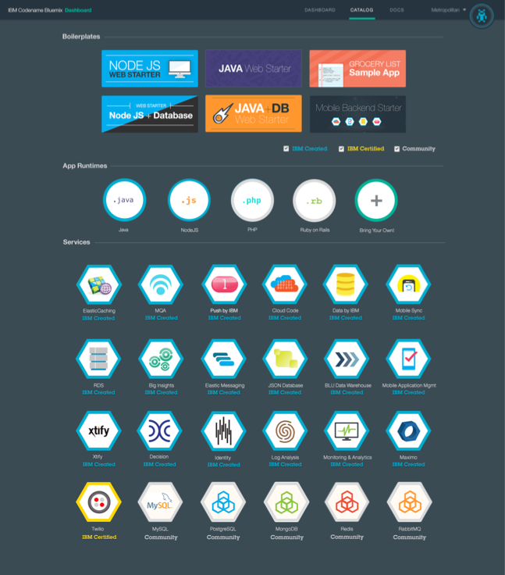



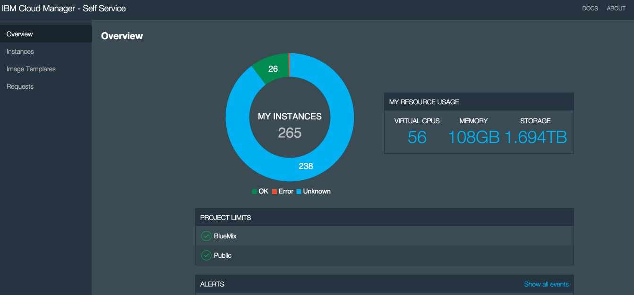
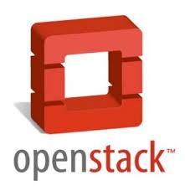
Bluemix on IBM Cloud Manager with OpenStack

Slide 18












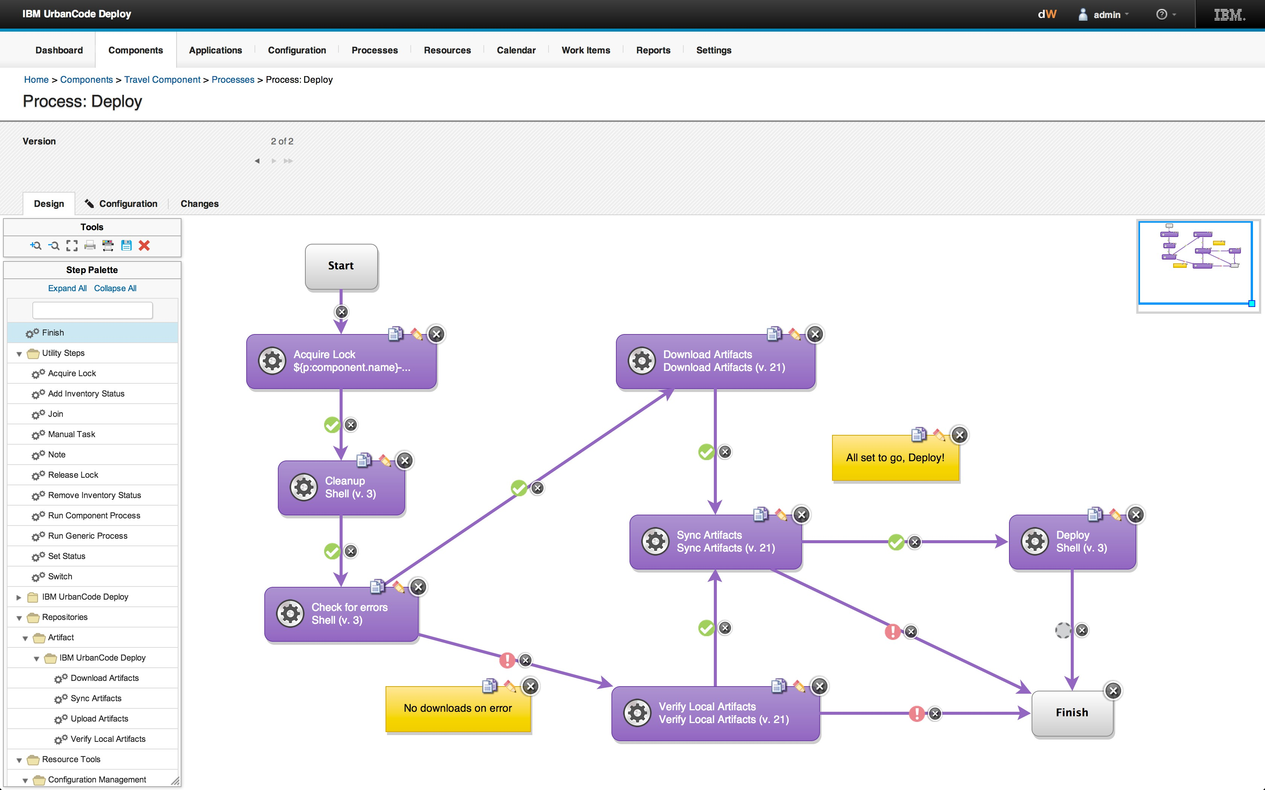








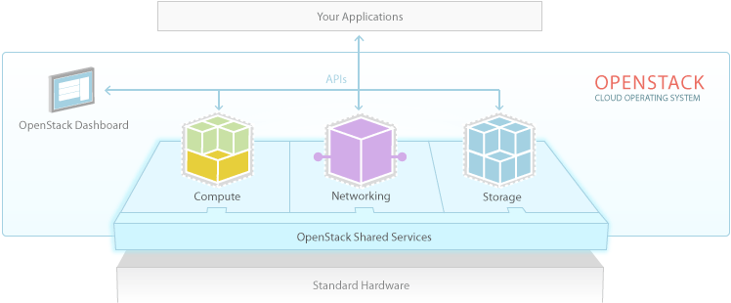

Bluemix on IBM Cloud Manager with OpenStack
LDAP
DataPower
Login server | Admin UI | Go router
BM UI | Metering | Logging
BM DB
Urban Code Bluemix Deployment Server
Urban Code Bluemix Deployment Client
…
…
…
BOSH
SSL VPN Tunnel
UAA | CC | DEAs | HM | Loggre gator
UAADB | CCDB | Blobst ore
Stemcells
PowerDNS
BOSH CLI
BOSH blobstore
Releases
Manifests
Cloud Provider Interface
NATS
Backup

Slide 19
BOSH - Deployment and Lifecycle management tool

Slide 20




BOSH – Cloud Foundry Deployment & Lifecycle Management Tool
LDAP
DataPower
Login server | Admin UI | Go router
BM UI | Metering | Logging
BM DB
…
…
…
BOSH
UAA | CC | DEAs | HM | Loggre gator
UAADB | CCDB | Blobst ore
Static / floating ips
Persistent disks
Custom VM Configurations
Specialized Security
groups
Cloud Provider Interface
NATS
Backup

Slide 21
BOSH Deployment Process
• BOSH deploys Cloud
Release
Stemcell
Deployment Manifest
Name
Software packages
Config templates
Scripts
Base OS
BOSH agent
Release name/version
# VMs, job params
Stemcells to use
BOSH
• •
• •
• | Virtual Machine
 |  | •
 |  | Software packages
Virtual Machine
Configuration Software Packages
Virtual Machine
Configuration Software Packages
Virtual Machine
Configuration Software Packages
Cloud Foundry
Configuration

Slide 22

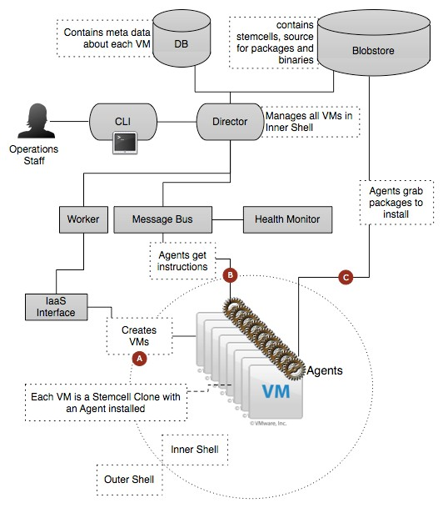
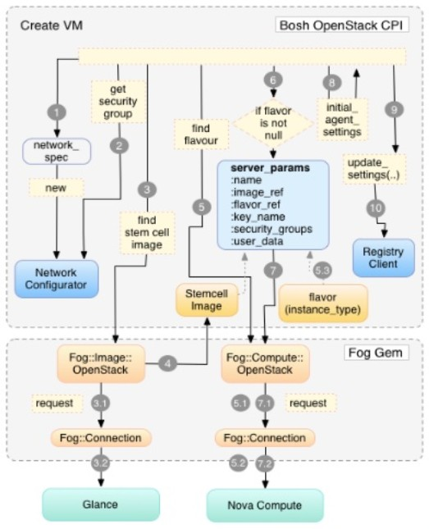
BOSH Architecture and OpenStack CPI
Leverages IaaS APIs to create VMs from base images packaged with operator-defined network, storage, and software configurations
Monitors and manages VM and process health, detecting and restarting processes or VMs when they become unhealthy.
Updates all VMs reliably and idempotently, whether the update is to the OS, a package, or component.

Slide 23














Scaling Cloud Foundry / BOSH
Optimize Internal Communication
Configure messaging bus for VM communication
Optimized routing and bandwidth allocation
Isolate Cloud Foundry components using multiple networks
Maintain Cloud Foundry’s Highly Available Architecture
Cloud Controllers
2x
3x
Service 10x
Gateways
Routers
20x
15x
Service Nodes
DEAs

Slide 24
IaaS Configuration
IBM Cloud Manager with OpenStack

Slide 25






IBM Cloud Manager with OpenStack (ICM) Architectural Overview
Cloud User
SCE Cloud Applications
OpenStack Applications
OpenStack Cloud Admin
Self Service UI
SCE API
CLI
Horizon UI
Cloud Manager User management Project
Network mapping Cloud admin
VM management
OpenStac k Adapter
Approvals Billing/accounts Metering reports Expiration policies Image activation
OpenStack 2014-2 API
OpenStack core projects
Nova drivers for
Hyper-V, KVM, vCenter
zVM driver
PowerVC driver
Legacy VMware adapter
OSGI
python
KVM
ppc
KVM
x86
Hyper
-V
PowerVC Standard
vCenter
zVM
PowerVM Power Systems
Power >=8
not in self service UI
vCenter

Slide 26
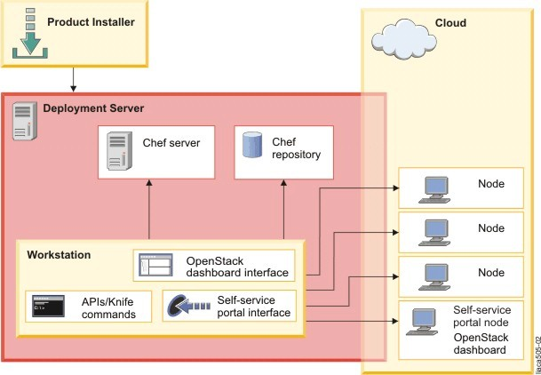
IBM Cloud Manager with OpenStack Deployment

Slide 27

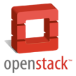
ICM Environment
ICM 4.3 - OpenStack Kilo+ KVM hypervisor
Support OpenStack APIs for automated consumption
Dedicated Compute serves to host Bluemix VMs (Nova)
Open vSwitch based Networking with GRE Tunnel
LVM, Storewize based Storage servers for persistent block storage (Cinder)
OpenStack management servers – in HA configuration
User management (Keystone)
Hardware requirements - Intel x servers
RedHat 6.5 OS for Juno, RedHat 7.1 OS for Kilo
Minimum of 3 systems (Deployer, Controller, Compute, Cinder Volume Node)
Controller Node: 4 cpu, 16GB memory, 3 NICs, 1 physical disk - 1 root disk of 300 GB (Can be substituted with Swift – Object Storage),
Deployer (Chef) Node: 8 CPU, 8GB memory, 2 NICs, at least 25GB of free disk space
Compute Nodes (Minimum per node recommended) : 16 cores, 64 GB RAM
Cinder Volume Node (Can be on Controller Node): 2 CPU, 4GB memory, 1 NICs, 2 physical disks, 1 of about 100 GB, another disk of 2.5 TB for Cinder Volumes
Total recommended from vCPU, Memory, Local Disk and Persistent Disk listed here (just for Bluemix)
~250 vCPUs, ~ 500 GB Memory, ~2 TB Local Disk, ~3 TB Persistent Disk
Internet
Bluemix Workload
Bluemix Workload
…
Bluemix Workload
OpenStack APIs
Horizon Cloud Management
Infrastructure as a Service
Compute
Virtualization
Bluemix Tenant
Infrastructure
Security
Storage
Network
Other requirements - Intel x servers
Accessible DNS Server
A wildcard domain name to use for CloudFoundry deployment
Accessible Yum server (RHEL updates)
Empty pass phrase SSH keys setup between controller node and compute nodes

Slide 28
ICM Sample YML environment File
Create a yml environment file like the following:
• # ================================================================
# Environment Information
• # ================================================================
environment:
base: example-ibm-os-single-controller-n-compute
default_attributes:
# (Optional) Add Default Environment Attributes
openstack.endpoints.compute-vnc-bind.bind_interface: 'ens224'
•
•
•
override_attributes:
# (Optional) Add Override Environment Attributes
ntp.servers: [0.pool.ntp.org, 1.pool.ntp.org, 2.pool.ntp.org, 3.pool.ntp.org]
•
•
•
•
•
openstack.compute.config.quota_cores openstack.compute.config.quota_instances openstack.compute.config.quota_ram
: '500'
: '500'
: '500000'
openstack.compute.config.quota_security_groups : '50'
openstack.compute.config.quota_volumes : '100'
•
•
•
•
•
•
•
•
openstack.endpoints.host: '9.30.182.239'
openstack.endpoints.bind-host: '9.30.182.239' openstack.network.openvswitch.tenant_network_type : 'gre'
openstack.network.openvswitch.network_vlan_ranges : ''
openstack.network.ml2.tenant_network_types openstack.network.ml2.network_vlan_ranges openstack.network.ml2.flat_networks
: 'gre'
: ''
: ''
openstack.network.l3.external_network_bridge_interface: "ens256"
•
•
•
•
•
•
•
•
•
## openstack.block-storage.volume.create_volume_group : 'true'
## openstack.block-storage.volume.create_volume_group_type : 'block_devices'
## openstack.block-storage.volume.block_devices : '/dev/sdb'
## openstack.block-storage.volume.volume_group_name : 'cinder-volumes'
: '10.22.22.238'
: 'http://9.30.140.50/allFiles/iCMO41/Sample-Images/rhel65_allowroot.qcow2'
: 'http://9.30.140.50/allFiles/bluemix/Inception/Clean-Inception.qcow2'
openstack.block-storage.volume.iscsi_ip_address openstack.image.upload_image.rhel65_allowroot openstack.image.upload_image.Ubuntu-Inception
openstack.image.upload_images : ['rhel65_allowroot' , 'Ubuntu-Inception']
# ================================================================

Slide 29
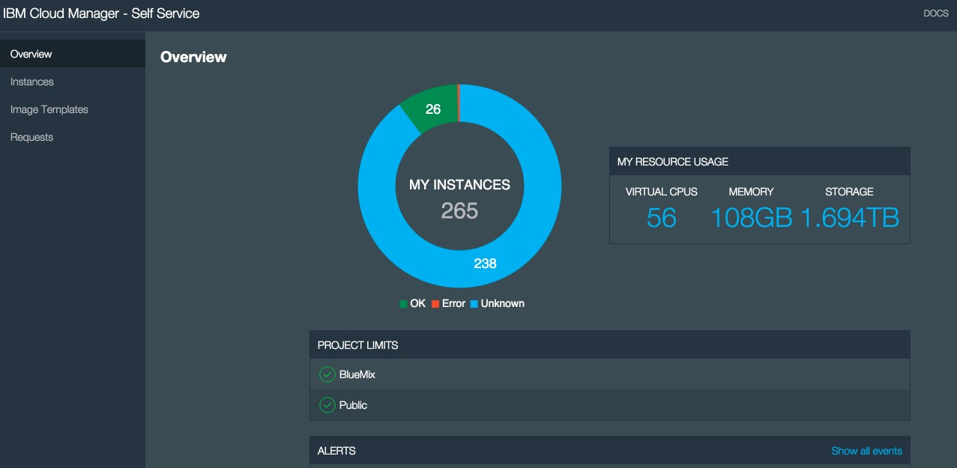
IBM Cloud Manager with OpenStack (ICM) Self Service UI

Slide 30
Inception Machine Bluemix Client

Slide 31


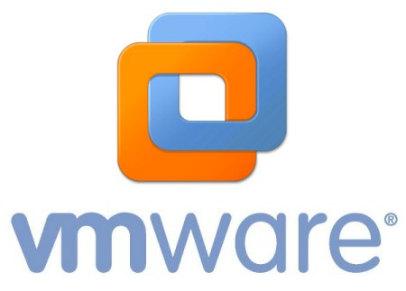





Converting a VMWare OVA to OpenStack Raw Image
Changes Required
Some of the images we were required to run were legacy Vmware images, which we needed to convert and run on OpenStack, our Inception image being one of them.
Ensure partioning is correct – no swap in end
Install cloud-init
Install isc-dhcp-client
Use qemu-img convert

Slide 32
Bluemix-ICM Networking Neutron

Slide 33















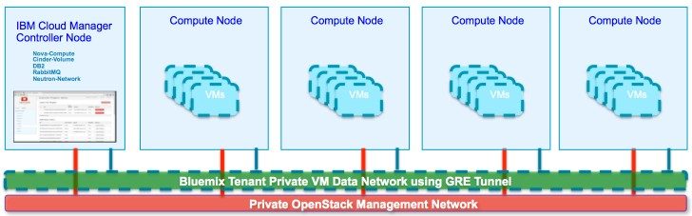
Neutron with Open vSwitch
LDAP
DataPower
Login server | Admin UI | Go router
BM UI | Metering | Logging
BM DB
Urban Code Bluemix Deployment Server
Urban Code Bluemix Deployment Client
…
…
…
BOSH
SSL VPN Tunnel
UAA | CC | DEAs | HM | Loggre gator
UAADB | CCDB | Blobst ore
Stemcells
PowerDNS
BOSH CLI
BOSH blobstore
Releases
Manifests
Cloud Provider Interface
NATS
Backup

Slide 34







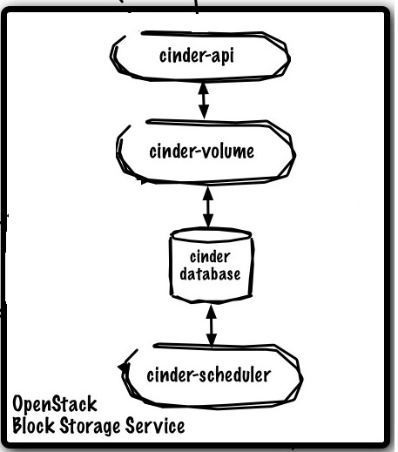

































Bluemix on ICM Architectural View
Bluemix Deployment Server
External shared Customer Network
IBM Cloud Manager Controller Node
Nova-Compute Neutron-Network DB2
RabbitMQ
Compute Node(s)
Compute Node
Bluemix Local Inception VA
Stemcells
Chef Server
Chef Repository
Releases
BOSH CLI
Manifests
Neutron Bluemix Tenant Router
UCD Agent
Bluemix Tenant Private VM Data Network using GRE Tunnel
Private OpenStack Management Network
Cinder Storage

Slide 35
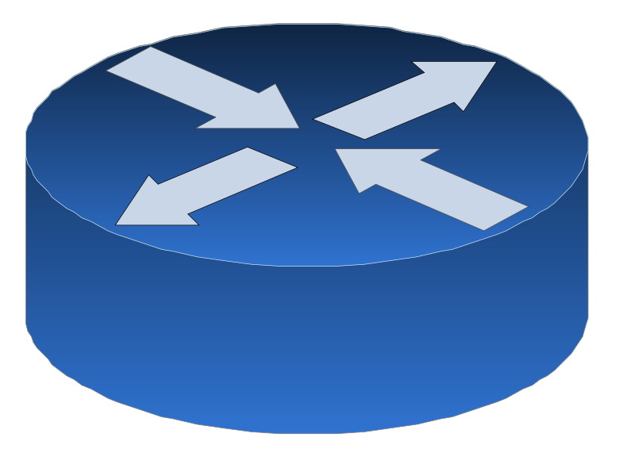

































Overall Network Setup
There is a minimum requirement of one customer accessible network, with outbound Internet capability.
External Shared Customer Network
Two VLANs, Public Network and a Private Network for ICM management & CloudFoundry VMs
IBM Cloud Manager Controller Node
Nova-Compute Cinder-Volume DB2
RabbitMQ
Neutron-Network
Compute Node
Compute Node
Neutron Bluemix Tenant Router
3 Nics on controller node – 2
connected to public network, and 1 connected to private network
Other
Other
Of the two Nics connected to
public network on controller node, only one should be assigned a public IP
Other
Other
VMs
VMs
VMs
VMs
Bluemix Tenant Private VM Data Network using GRE Tunnel
Minimum 10 contiguous floating IP Address for public network
Private OpenStack Management Network

Slide 36






















Bluemix Local on ICM - VM Networking View
Physical Router
External Shared Customer Network
Neutron Bluemix Tenant Router
Other
Tenant Router
Bluemix Tenant Private VM Data Network using GRE Tunnel
Tenant Private Network
Other VMs
Other VMs
Other VMs
Bluemix Tenant VMs
Other Tenant VMs

Slide 37
Bluemix Gateway Datapower

Slide 38
DataPower is the Elastic Gateway
Proxy – Connection Termiation Point
TCP Connection End Point
SSL Connection End Point / SSL Offloading
WebSockets
IP Spraying
Using DataPower Self-Balancing Technology
Backend Load Balancing
URL Rewrites
SLM
Service Level Monitoring to protect DataPower and the backend apps
Backend can be applications, services, or members of the Bluemix fabric (gorouter, logging server)
Global rate limiting
Platform Enforcement Point (PEP) for OAuth
Protecting access to applications
38

Slide 39






















DataPower is the Ingress to Bluemix
Services Cloud Integration Elastic Caching
Logging/Heath/Analytics/ License Acceptance
Applications Barry.myblueix.net Acme.myblueix.net
.
HA Proxy
App Router
(go)router 1
(go)router 2
.
(go)router n
All Inbound Traffic
DataPower 1
DataPower 2
Services Mongodb WorkFlow geocoding
.
HTTP/HTTPS/WebSockets
User Account and Authentication Server (UAA)
Cloud Controller
ACE
WebConsole/Dashboard

Slide 40

















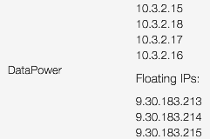





Datapower Networking View
External Shared Customer Network
Bluemix Tenant
VM Data Network using GRE Tunnel
local.bluemix.net
DataPower Elastic Gateway
Neutron Bluemix Tenant Router
Go Router
All Inbound Traffic
Custom
HTTP/HTTPS/WebSockets
Domain(s)
local.mybluemix.net
Go Router

Slide 41
Bluemix Automated Deployment Urban Code Deploy

Slide 42
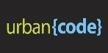




Importing Component Artifacts Into UCD For Deployment Purposes
Restricted Cloud or Public Internet
Urban Code Deploy
Rational Asset Manager
Agent
Server Server
Load Balancer
SCM Systems GitHub/RTC
Agent
Maven e.g. Nexus
Agent
Docker / IBM Container Services Containers
Agent
Agent Relay Server
* Agent Relays can be optionally used as a network proxy to handle restricted network paths

Slide 43
Deploying and Configuring UCD Endpoints
Environment A
Relay Server
Agent
Urban Code Deploy
Agent
Agent
Server Server
Agent Relay Server
Environment B
Load Balancer
Agent Relay Server
Agent
Agent
Agent
Agent
Agent

Slide 44
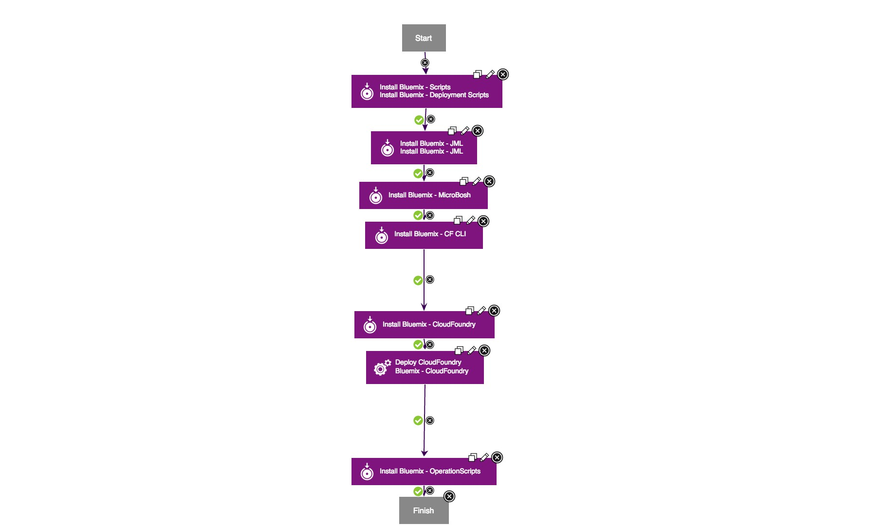
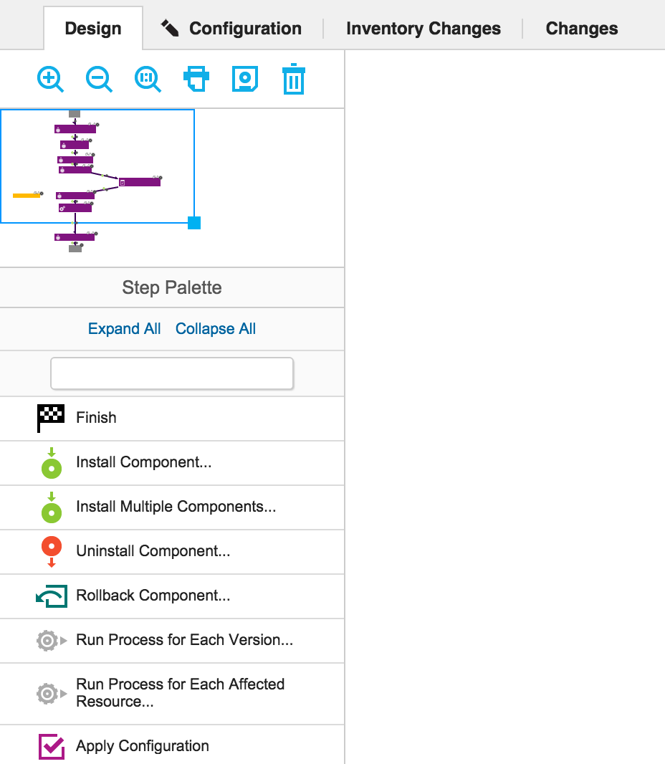
Bluemix UCD Process Design

Slide 45
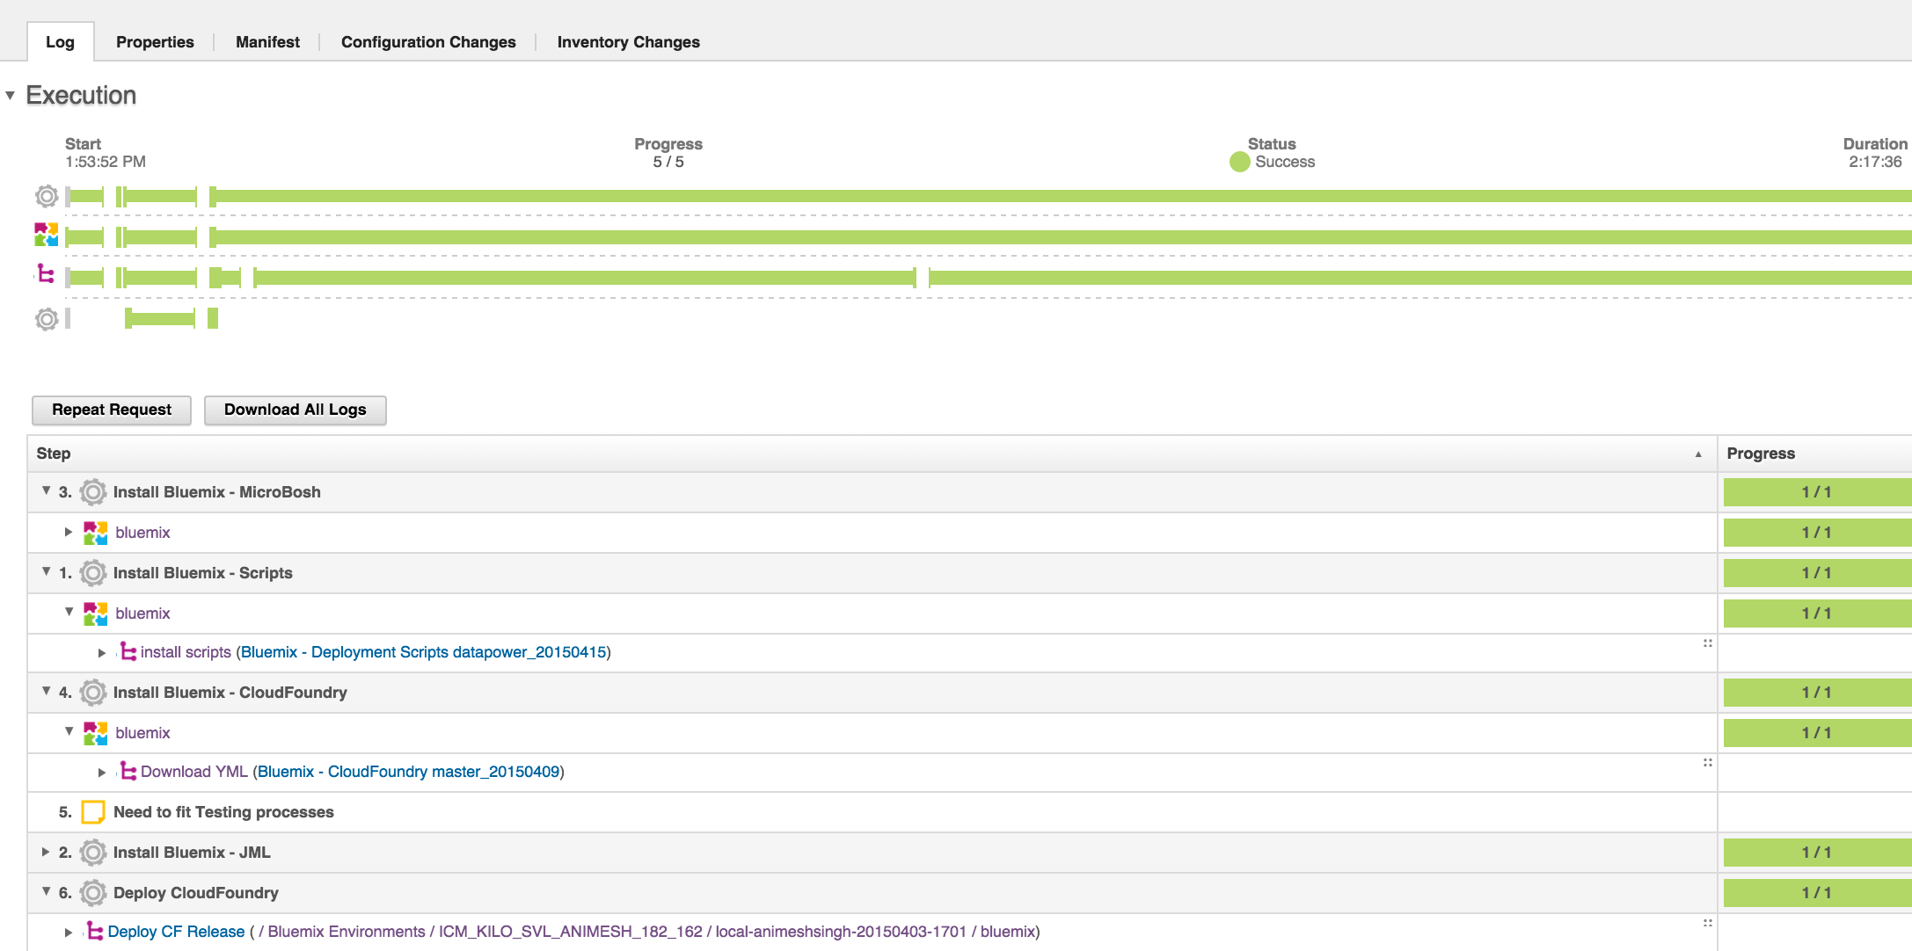
Bluemix UCD Deployment Flow

Slide 46




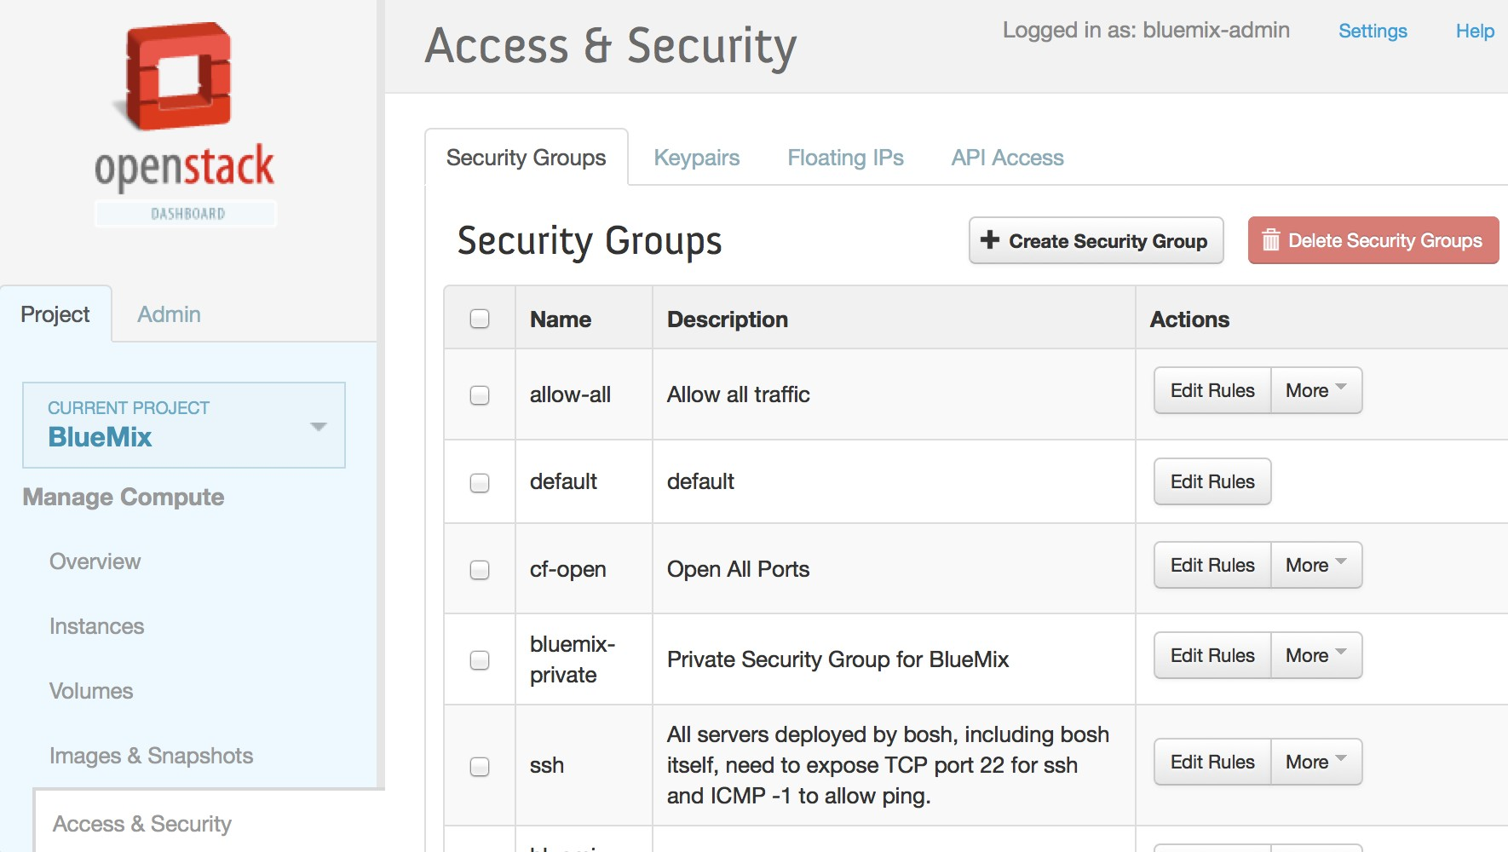




Fog for OpenStack Discovery Automation
OpenStack Discovery:
Leverage the open source Fog gem to discover OpenStack artifacts in an automated manner
Require OpenStack credentials and discover OpenStack compute and network information.
Discover Security Credentials
Discover VM Configuration Sizes
Discover Network Subnets
Discover Network Security Rules
Discover DHCP , DNS Gateway and floating IPs

Slide 47


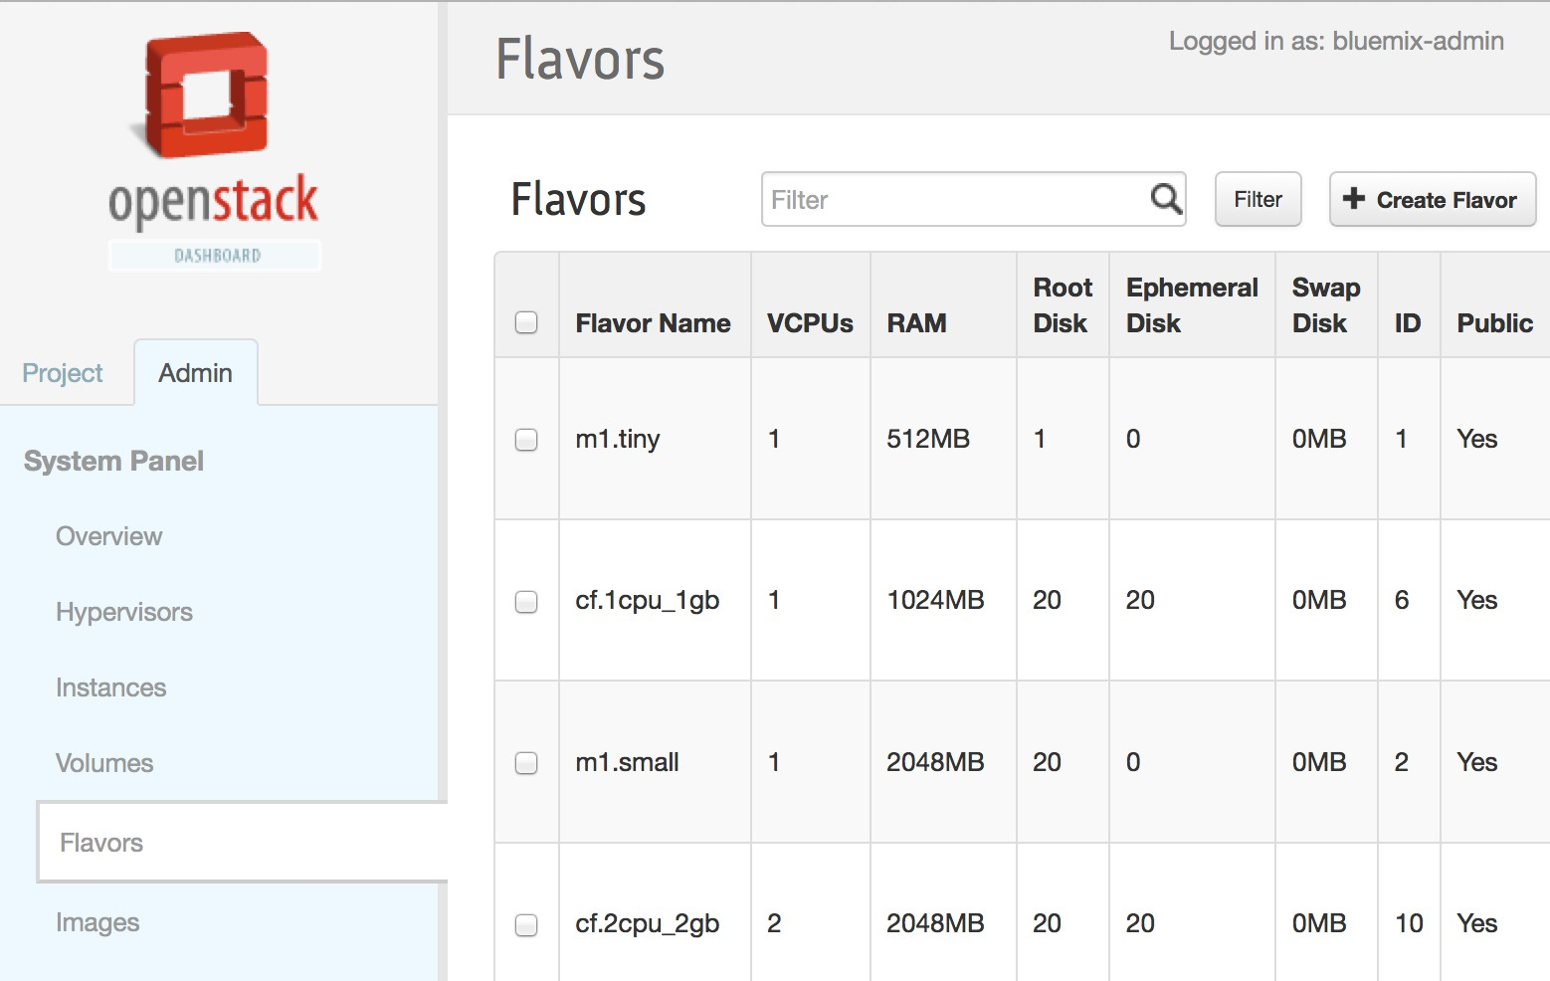


Fog for OpenStack Setup Automation
Cloud Foundry Pre-req setup on OpenStack:
Leverage the open source Fog gem to setup Cloud Foundry requirements in an automated manner
Setup according to best practices and guidelines – still giving users the flexibility to change if desired
Create Security Credentials
Create VM configs for Router, DEAs, Cloud Controller, Service
Nodes
Create network Security Rules
Setup tenant quota

Slide 48




Fog for Datapower VM Setup Automation
Datapower setup on OpenStack:
Leverage fog Neutron and Nova support to provision and configure Datapower VM
Create Neutron port requesting multiple IP addresses from DHCP
Call Nova compute to provision a VM with that port
Pass Metadata file to persist those Ips to VM`s ethernet interface

Slide 49





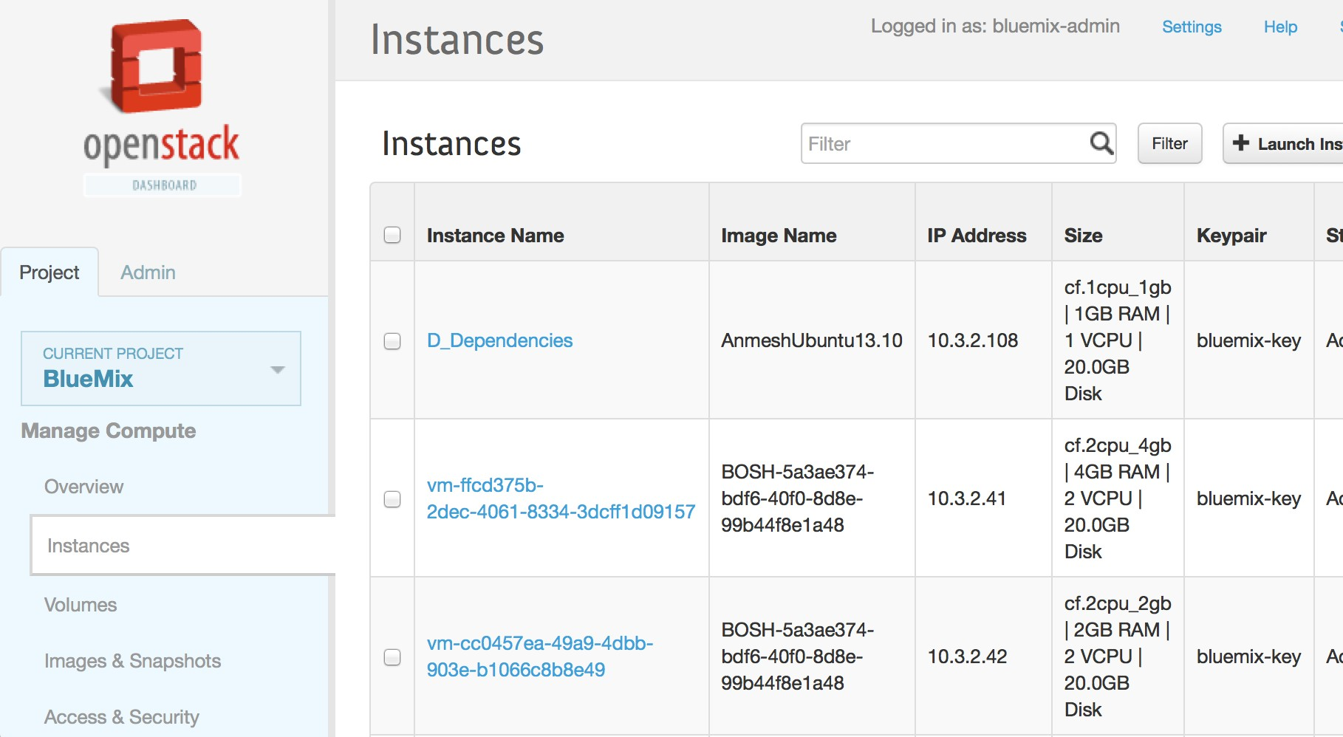




BOSH and Ruby for Cloud Foundry Deployment Automation
Cloud Foundry Deployment Automation
Automate base OS image creation or modification
Automate Cloud Foundry deployment manifest file genration using Ruby ERB
Automate upload of Cloud Foundry core release, services and runtime frameworks, followed by Cloud Foundry deployment
BOSH RUBY
Stemcell Creation and Upload
Generate BOSH and Cloud Foundry Manifest
Deploy Microbosh
Upload Cloud Foundry core, Services and runtime
Deploy Cloud Foundry

Slide 50


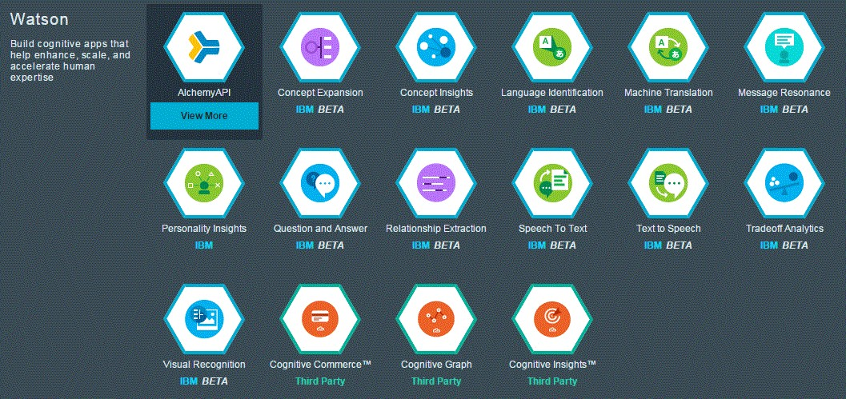


Updates/Upgrades Automation!
Automate the update/upgrade lifecycle operations
•
•
Updates can be automated using code from the initial automated deployment (e.g. bosh deploy) Follow the same workflow – do OpenStack discovery operation, and then leverage BOSH for update/ upgrade/
To ensure application availability throughout the update, use tools like JMeter to test application responsiveness
•

Slide 51
Monitoring/Logging Graphite/Grafana/ELK Stack

Slide 52
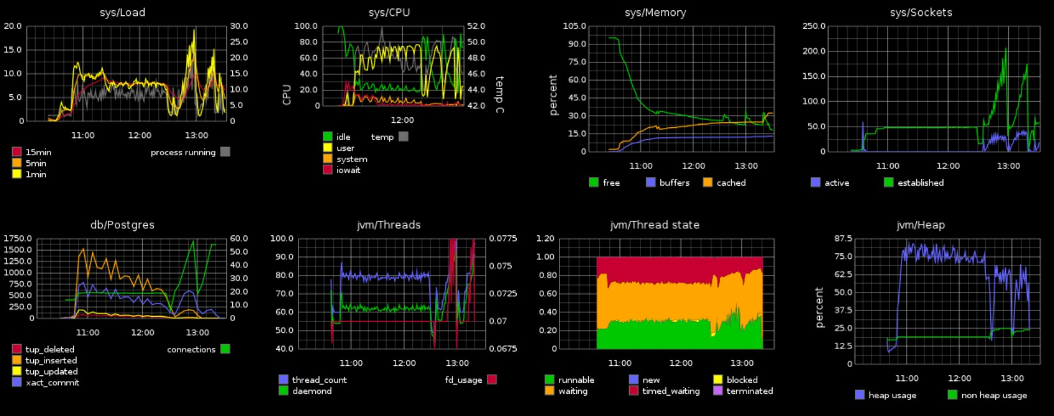
Monitoring based on open source Graphite/Graphana
Graphite is a highly scalable real-time graphing system. As a user, you write an application that collects numeric time-series data that you are interested in graphing, and send it to Graphite’s processing backend, carbon, which stores the data in Graphite’s specialized database.

Slide 53
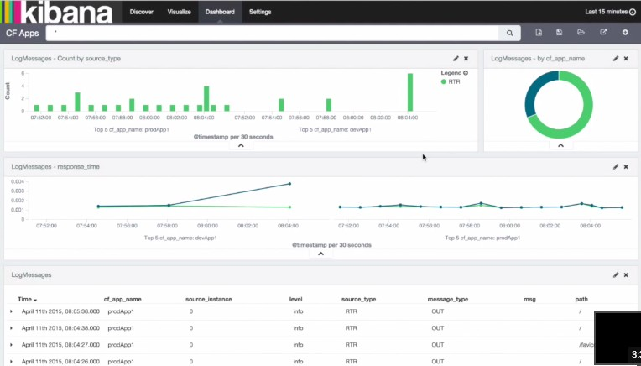
Logging based on open source ELK Stack
The “ELK” Stack
elasticsearch - indexes and stores all the log data
logstash - plays multiple roles from receiving, parsing, and archiving data
kibana - displays log data in meaningful charts and tables

